Slide 1
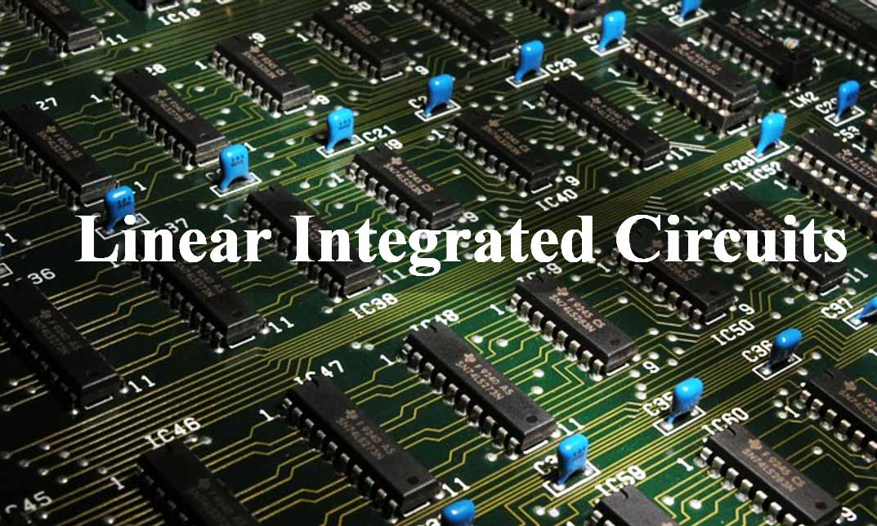
15EC502 – Linear Integrated Circuits

Slide 2
UNIT I IC FABRICATION AND CIRCUIT CONFIGURATION FOR LINEAR ICS
Advantages of ICs over discrete components
Manufacturing process of monolithic ICs
bipolar transistor
diodes
Integrated Resistors
Capacitors
Inductors.
Differential gain – CMRR
General operational amplifier stages
Internal circuit diagrams of IC 741
DC and AC performance characteristics
Slew rate
Open and closed loop configurations

Slide 3
Advantages of ICs over discrete components
Miniaturization and hence increased equipment density
Cost reduction due to batch processing
Increased system reliability due to elimination of soldered joints
Improved functional performance.
Matched devices.
Increased operating speeds.
Reduction in power consumption.
packaged ICs use much less material than discrete circuits
Uniformity of components
Ease of manufacture
Speed, Size, Cost, Power Consumption improvement
More robust against vibration

Slide 4
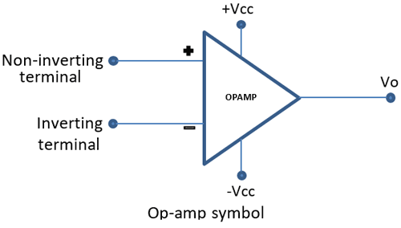
Basic Information of Op-Amp
Op-Amp Symbol

Slide 5
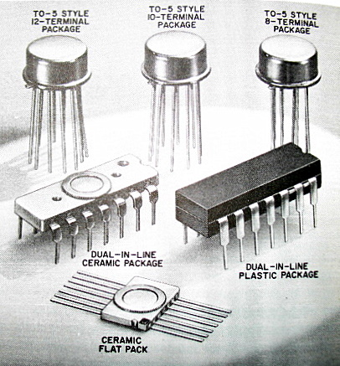
Basic Information of Op-Amp
Packages
The Metal Can (TO) Package
The Dual-in-line Package
The Flat package or Flat pack

Slide 6
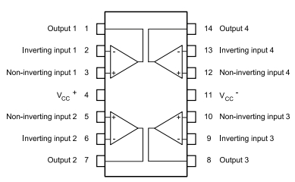
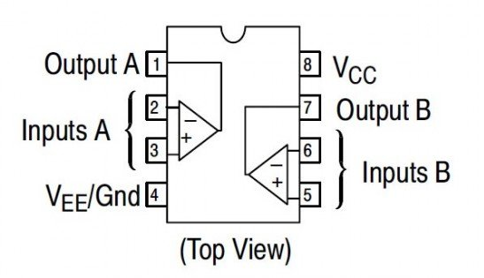
Basic Information of Op-Amp
Package may contain Single, Two (Dual) or Four (Quad) Op-Amps
Number of pins (8 – CAN, DIP; 10 - Flat; 14 – IP)

Slide 7
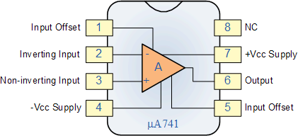
Basic Information of Op-Amp
Op-Amp Terminals

Slide 8
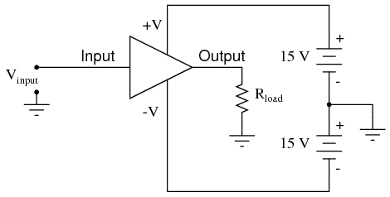
Basic Information of Op-Amp
Op-Amp Power Supply Connections
Gnd is Must, otherwise twice the supply damage the Op-Amp.

Slide 9
Basic Information of Op-Amp
Op-Amp Power Supply Connections
Instead of single power supply,
Use resistive divider
Use Zener Diodes
Use of Potentiometer and Diodes.

Slide 10
Basic Information of Op-Amp
Op-Amp Manufacturers
Fairchild - µA, µAF
National Semiconductor - LM, LH, LF, TBA
Motorola - MC, MFC
RCA - CA, CD
Texas Instruments - SN
Signetics - N/S, NE/SE
Burr/Brown - BB
Op-Amp Numbers will end up with 741 (Ex.: LM 741)

Slide 11
Basic Information of Op-Amp
Op-Amp Manufactured for….
741 - Military Purpose (Temp. -55°C - 125°C)
741C - Commercial (Temp. 0°C - 75°C)
741A - Improved version of 741
741E - Improved version of 741C
741S - Military with High Slew-Rate
741SC - Commercial with High Slew-Rate
Electrical Properties

Slide 12
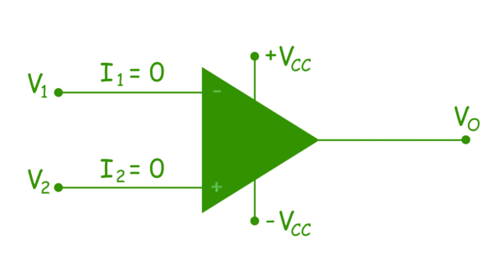
Ideal Op-Amp Characteristics

Slide 13
Ideal Op-Amp Characteristics
Characteristic | Value
Open Loop Gain (A) | ∝
Input Resistance | ∝
Output Resistance | 0
Bandwith of Operation | ∝
Offset Voltage | 0

Slide 14
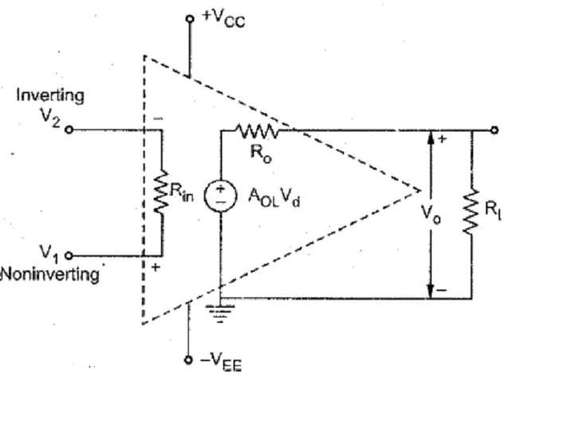
Ideal Op-Amp Equivalent Circuit

Slide 15
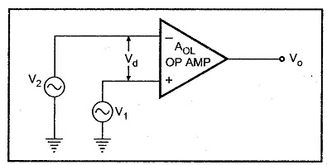
Op-Amp Open Loop

Slide 16
Op-Amp Closed Loop
Assumptions
Current drawn by either of the input terminals is negligible.
The differential input voltage V_{d} is essentially Zero.

Slide 17
Op-Amp Closed Loop
Configurations
Inverting Amplifier
Non-Inverting Amplifier
Voltage Follower
Differential Amplifier

Slide 18
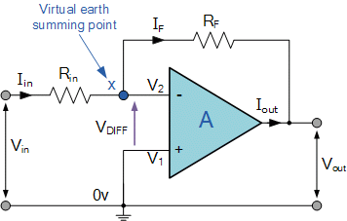
Op-Amp Closed Loop
Inverting Amplifier
No Current Flows into the Input Terminals
The Differential Input Voltage is Zero as V1 = V2 = 0 (Virtual Earth)

Slide 19
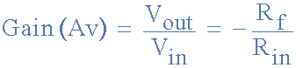
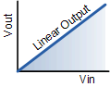

Op-Amp Closed Loop
Inverting Amplifier
Closed-Loop Voltage Gain is,

Slide 20
Problem
Design an Amplifier with a gain of -10 and input resistance equal to 10kΩ..
Solution:
Given
Gain = -10
Ri = 10kΩ

Slide 21
Problem
Design an Amplifier with a gain of -10 and input resistance equal to 10kΩ..
Solution:
Given
Gain = -10
Ri = 10kΩ
Rf = -A_{CL} Ri = - (10)(10kΩ) = 100kΩ

Slide 22
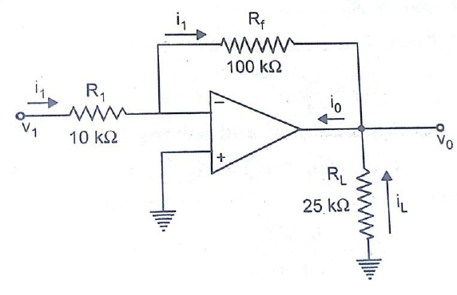
Problem
In an Inverting Amplifier, R₁= 10kΩ , Rf= 100kΩ, Vi=1V. A load of 25kΩ is connected to the output terminal. Calculate,
i₁, V₀, i_{L}, and Total Current i₀?
Solution:
Given
R₁= 10kΩ ,
Rf= 100kΩ,
Vi=1V,
A load of 25kΩ

Slide 23
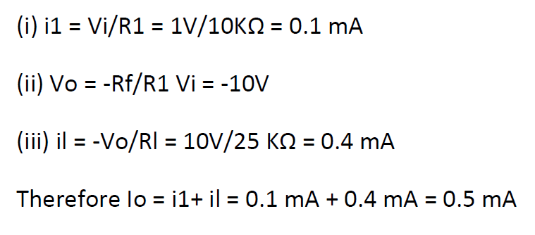
Problem

Slide 24
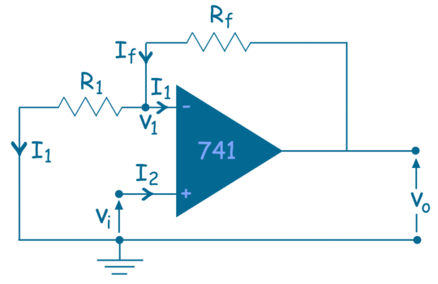
Op-Amp Closed Loop
Non-Inverting Amplifier
No Current Flows into the Input Terminals
The V_{d} Differential Input Voltage is Zero. Hence, Potential at V₁ = Vi

Slide 25
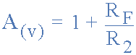
Op-Amp Closed Loop
Non - Inverting Amplifier
Closed-Loop Voltage Gain is,

Slide 26
Problem
Design an Amplifier with a gain of +5 using an Op-Amp.
Solution:
Given
Gain = +5

Slide 27
Problem
Design an Amplifier with a gain of +5 using an Op-Amp.
Solution:
Given
Gain = +5
Assume, R₁ = 10kΩ
A_{CL} = (1+ (R_{f}/R₁)) => 5 = 1+ (R_{f}/R₁) =>
R_{f} = 40kΩ

Slide 28
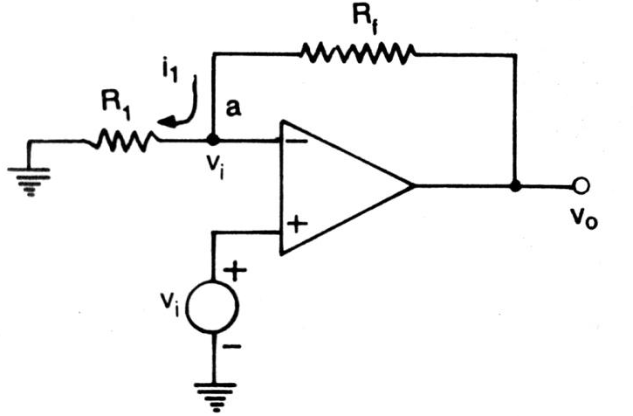
Problem
In an Non-Inverting Amplifier, R₁= 5kΩ , R_{f}= 20kΩ, Vi=1V. A load of 5kΩ is connected to the output terminal. Calculate,
V₀, A_{CL}, i_{L}, Total Current i₀ and direction of flow?
Solution:
Given
R₁= 5kΩ ,
Rf= 20kΩ,
Vi=1V,
A load of 5kΩ

Slide 29
Problem
Solution:
V₀=V_{i}(1+ (R_{f}/R₁)) = 5V
A_{CL} = V₀/V_{i} = 5
i_{L} = V₀ / R_{L} = 1mA
i₁ = V_{i}/R₁ = V₀-V_{i} = 0.2mA
i₀ = i_{L} + i₁ = 1.2mA

Slide 30
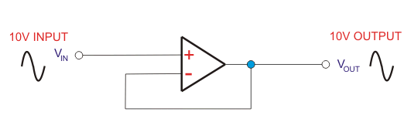
Op-Amp Closed Loop
Voltage Follower
R_{f}=0; Ri=Infinity; Vo=Vi; R₀=0
Used for Impedance Matching Circuitry.

Slide 31
Op-Amp Closed Loop
Voltage Follower
Advantages of Voltage Follower
Provides power gain and current gain.
Low output impedance to the circuit which uses the output of the voltage follower.
The Op-amp takes zero current from the input.
Loading effects can be avoided.
Applications of Voltage Follower
Buffers for logic circuits.
In Sample and hold circuits.
In Active filters.
In Bridge circuits via transducer.

Slide 32
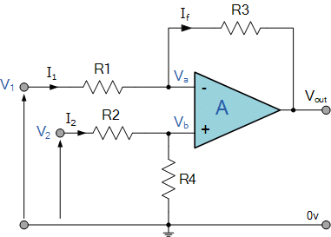
Op-Amp Closed Loop
Differential Amplifier

Slide 33
Op-Amp Closed Loop
Analysis
Assume, it is ideal Op-Amp,
Current in to the Op-Amp is Zero.
V_{d}=0; then, V_{a}=V_{b}.
At Node ‘a’,
(V_{a} – V₁)/R₁ + (V_{a} – V₀)/R₃ = 0 ----- (1)
At Node ‘b’,
(V_{b} – V₂)/R₂ + (V_{b} – 0)/R₄ = 0 ----- (2)
In equation (2), put R₂=R₁ and R₄ = R₃, and Rearranging,
(1) => V_{a} (1/R₁ – 1/R₃) – (V₁/R₁) = V₀/R₃ ----- (3)
=> V_{a} (1/R₁ – 1/R₃) – (V₂/R₁) = 0 (ஃ V_{a} = V_{b}) ----- (4)
Subtract (3) – (4),
-(V₁/R₁) + (V₂/R₁) = V₀/R₃ ----- (5)
Rearranging the above,
V₀ = R₃/R₁ (V₂-V₁)

Slide 34
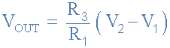
Op-Amp Closed Loop
Differential Amplifier
Consider V₁=V₂=V₃ Find A_{CL}?
R1 = R2 = R3 = R4 then the circuit will become a Unity Gain Differential Amplifier

Slide 35
Difference Mode and Common Mode Gain
If V₁ = V₂ => V₀ = ‘0’ (ஃ both inputs are cancelled and no output - Ideal)
But, Practically V₀ is not Zero for Common Mode.
Case i: V₁=100µV & V₂=50µV; then V₀= V₃.
Case ii: V₁=1000µV & V₂=950µV; then V₀= V₄.
V₃ is not equal to V₄; even V₁-V₂ is same both cases.
Hence, output voltage is dependent on V_{d} and V_{CM}.
V_{CM} = (V₁+V₂) / 2
Reason: Components Mismatch

Slide 36
Difference Mode and Common Mode Gain
Hence, Output Voltage is,
V₀ = A₁V₁ + A₂V₂ ----(1)
Where, A₁ = Gain of Input 1, when input 2 is Grounded.
A₂ = Gain of Input 2, when input 1 is Grounded.
Differential mode component : V_{d} = (V₁-V₂) Common mode component : V_{cm} = (V₁+V₂)/2
V_{cm} = (V₁+V₂)/2 ----(2) & 2V_{cm} = V₁ + V₂ ---- (3)
Since V_{d} = V₁ - V₂ ---- (4)
Therefore
(3) + (4) & V₁ = V_{cm} + V_{d}/2 ---- (5)
and (3) - (4) & V₂ = V_{cm} - V_{d}/2 ---- (6)

Slide 37
Difference Mode and Common Mode Gain
Sub. (5), (6) in eqn. (1), we get,
V₀ = A_{DM} V_{d} + A_{CM} V_{c}.
Where,
Difference Mode Gain A_{DM} = (1/2)(A₁ – A₂)
Common Mode Gain A_{CM} = A₁+A₂
Hence, Common-Mode Rejection Ratio (CMRR) is,
CMRR (ρ) = | A_{DM} / A_{CM} |

Slide 38
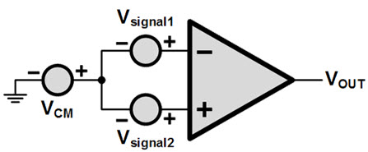
Common Mode Rejection Ratio
CMMR = Differential mode gain / Common-mode gain
CMRR used to be in the range of 80 to 100 dB
Hence, Common-Mode Rejection Ratio (CMRR) is,
CMRR (ρ) = | A_{DM} / A_{CM} |
Ideally, ADM is Large and ACM is Zero; So that, CMRR = HIGH (for Good Op-Amp).
Ref.:: https://www.youtube.com/watch?v=hpCu3HbAiWg

Slide 39
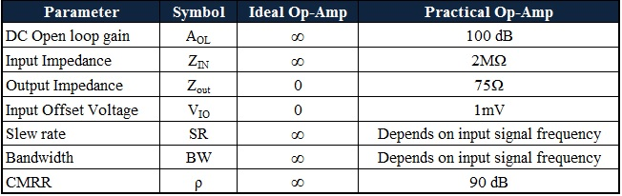
DC Characteristics of Op-Amp
Ideal Op-Amp draws no current from the source and independent of Temperature.
Practically, current is taken from the source into the Op-Amp inputs.
Two inputs respond differently to Current and Voltage due to Mismatch.
Real Op-Amp has dependent on temperature.
Non-Ideal Characteristics are,
Input Bias Current.
Input Offset Current
Input Offset Voltage
Thermal Drift

Slide 40
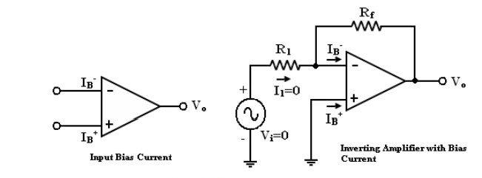
1. Input Bias Current
The Differential amplifier may be FET or BJT based device.
In Ideal op-amp, we assume no current is drawn by the inputs.
In Practical due to mismatch of components current drawn in both the terminals.
They are named as I_{B}⁺ and I_{B}⁻
I_{B} = (I_{B}⁺ and I_{B}⁻ ) / 2

Slide 41
1. Input Bias Current
For BJT this I_{B} is 500nA and for FET I_{B} is 50pA
Ex.: if I_{B} = 500nA, V_{i} = 0, then V₀ is,
V₀ = (I_{B}⁻ R_{f})
if R_{f} = 100MΩ then,
V₀ = 500mV
The output is driven to 500mV with zero input, because of the bias currents.

Slide 42
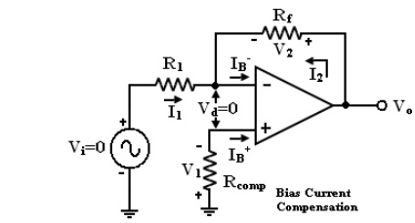
1. Input Bias Current (with R_{comp})

Slide 43
1. Input Bias Current (with R_{comp})
Analysis
Current I_{B}⁺ flowing through the compensating resistor R_{comp}, then by KVL,
-V₁+0+V₂-V_{o} = 0 (or) ——>(1)
V_{o} = V₂ – V₁ ——>(2)
By selecting proper value of R_{comp}, V₂ can be cancelled with V₁ and the V_{o} = 0. The value of R_{comp} is derived
V₁ =I_{B}⁺R_{comp} ——>(3)
I_{B}⁺ = V₁/R_{comp} ——>(4)

Slide 44
1. Input Bias Current (with R_{comp})
The node ‘a‘ is at voltage (-V₁). Because the voltage at the non-inverting input terminal is (-V₁). So with Vi = 0
I₁ = V₁/R₁ ——>(5)
I₂ = V₂/R_{f} ——>(6)
For compensation, Vo should equal to zero (V_{o} = 0, V_{i} = 0). i.e. from equation (2) V₂ = V₁. So that from (6)
I₂ = V₁/R_{f} ——>(7)
KCL at node ‘a‘ gives,
I_{B}⁻= I₂ + I₁ add eqn, (5) and (7), we get,
I_{B}⁻= V₁ ((R₁ + R_{f})/R_{f}R₁) ——>(8)
Assume I_{B}⁻ = I_{B}⁺ then from (4) & (8),
R_{comp} = ((R₁ + R_{f})/R_{f}R₁) = R₁ || R_{f}

Slide 45
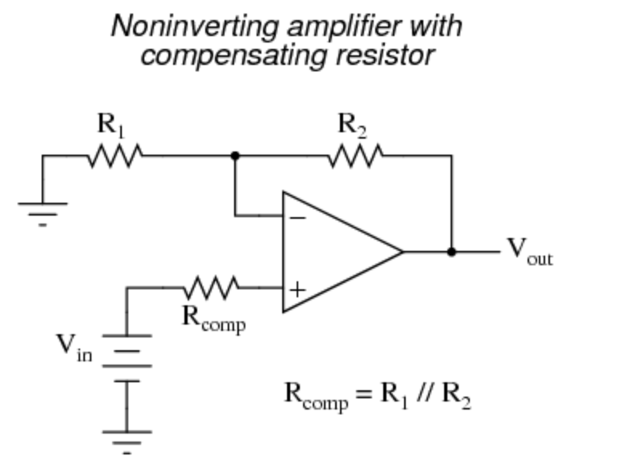
1. Input Bias Current (with R_{comp})
Analysis
R_{comp} = ((R₁ + R_{f})/R_{f}R₁) = R₁ || R_{f}
Ref.: http://www.brainkart.com/article/DC-Characteristics-of-op-amp_13376/

Slide 46
2. Input Offset Current
Bias current compensation will work if both bias currents I_{B}⁺ and I_{B}⁻ are equal.
Since the input transistor cannot be made identical. There will always be some small difference between I_{B}⁺ and I_{B}⁻. This difference is called the offset current.
|I_{os}| = I_{B}⁺ -I_{B}⁻
——>(1)
Offset current I_{os} for BJT op-amp is 200nA and for FET op-amp is 10pA. Even with bias current compensation, offset current will produce an output voltage when V_{i} = 0.

Slide 47
2. Input Offset Current
V₁ =I_{B}⁺R_{comp} ——>(2)
I₁ = V₁/R₁ ——>(3)
KCL at node ‘a‘ gives,
I_{B}⁻= I₂ + I₁
——>(4)
I₂ = (I_{B}⁻ - I₁ )
——>(5)
In (5), use (2) and (3) we get,
I₂ = (I_{B}⁻ - (I_{B}⁺R_{comp} /R₁)) ——>(6)

Slide 48
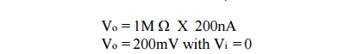
2. Input Offset Current
V_{o} = V₂ – V₁ ——>(7)
V_{o} = I₂ R_{f} – V₁ = I₂ R_{f} – I_{B}⁺R_{comp} ——>(8)
Sub. (6) in (8) and simplifying we get,
V_{o} = R_{f} (I_{B}⁻ – I_{B}⁺) ——>(9)
V_{o} = R_{f} (I_{os})

Slide 49
2. Input Offset Current
The offset current can be minimized by keeping feedback resistance small.
Unfortunately to obtain high input impedance, R₁ must be kept large.
R₁ large, the feedback resistor R_{f} must also be high. So as to obtain reasonable gain.

Slide 50
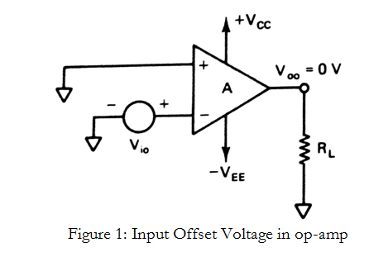
3. Input Offset Voltage
Inspite of the use of the above compensating techniques, it is found that the output voltage may still not be zero with zero input voltage [V_{o} ≠ 0 with V_{i} = 0].

Slide 51
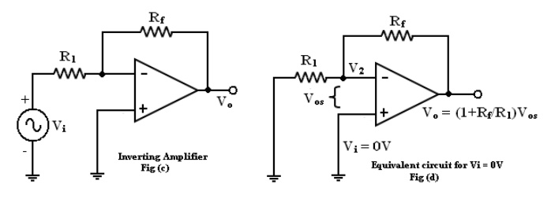
3. Input Offset Voltage
At node V₂ apply nodal equation and find V₀?
V₀ = V₂ (1+(R_{f} /R₁))
——>(1)
V_{ios} = |V_{i} -V₂| and V_{i} = 0.
——>(2)
V₀ = V_{ios} (1+(R_{f} /R₁))
From (1) and (2) =>

Slide 52
4. Total Output Offset Voltage
The total output offset voltage V_{OT} could be either more or less than the offset voltage produced at the output due to input bias current (I_{B}) or input offset voltage alone(V_{os}).
This is because I_{B} and V_{os} could be either positive or negative with respect to ground.
V_{OT} = V_{ios} (1+(R_{f} /R₁)) + R_{f} (I_{os})

Slide 53
6. Thermal Drift
Bias current, offset current, and offset voltage change with temperature.
A circuit carefully nulled at 25ºC may not remain. So when the temperature rises to 35ºC. This is called drift.
Offset current drift is expressed in nA/ºC or mV/ºC.
These indicate the change in offset for each degree Celsius change in temperature.

Slide 54
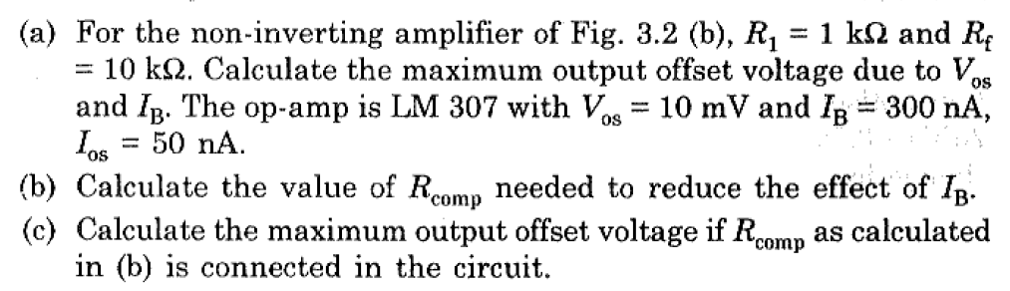
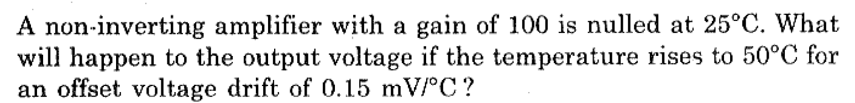
Problem: 1
Problem: 2

Slide 55
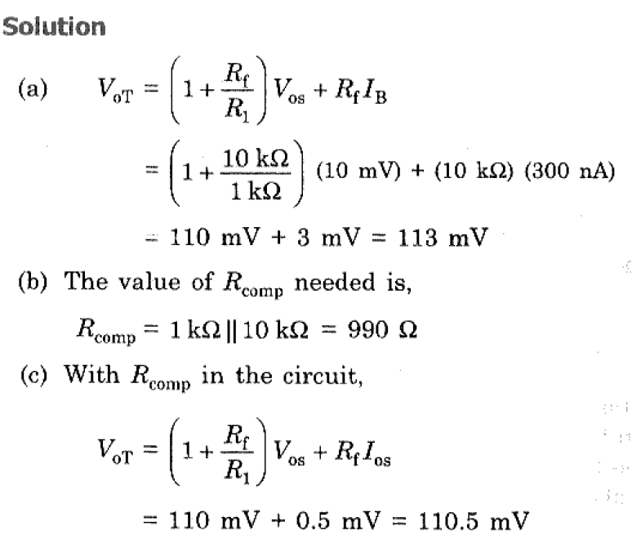
Problem: 1

Slide 56
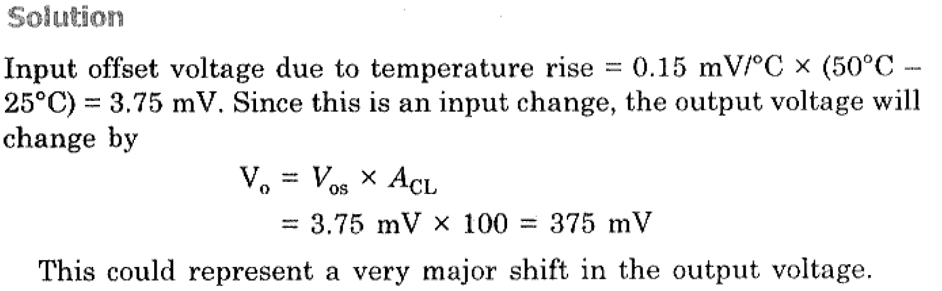
Problem: 2

Slide 57
OP AMP APPLICATIONS
Two types of Applications,
Linear Applications
Non-Linear Applications

Slide 58
Linear Applications
Addition
Subtraction
Multiplication
Current to Voltage and Voltage to current conversion
Integration
Differentiation
Active Filters
Comparators
Schmitt trigger
Instrumentation Amplifier
F to V converter

Slide 59
2. Non-Linear Applications
Comparators
Logarithmic amplifiers
Exponential amplifiers
Peak detectors
Precision rectifiers
Waveform generators
Clippers & clampers

Slide 60
Inverter and Scale Changer
Linear Applications
Inverting Amp with Gain = - Rf / Ri
Inverter
Rf / Ri = 1
Inverter and Scale Changer
Proper choice of Rf / Ri
Application
Use of inverter to scale the output of DAC

Slide 61
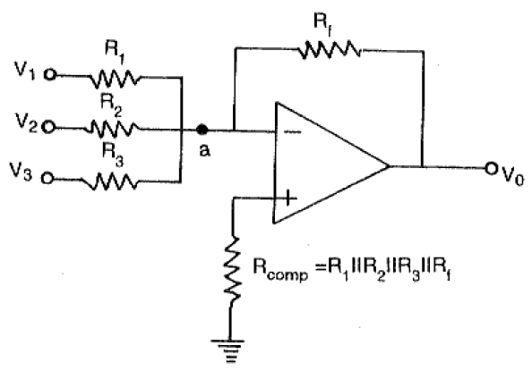
Summing Amplifier (Inverting)
Linear Applications

Slide 62
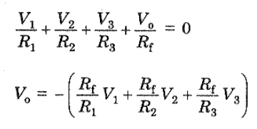
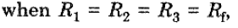
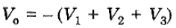
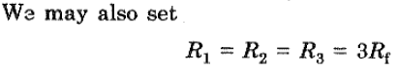
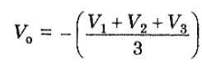
Summing Amplifier (Inverting)
Linear Applications

Slide 63
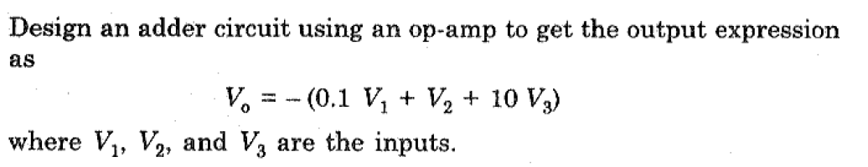
Summing Amplifier (Inverting)
Linear Applications
Problem

Slide 64
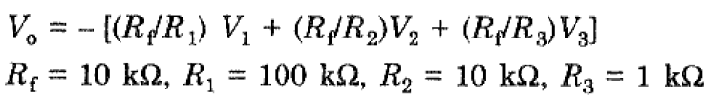
Summing Amplifier (Inverting)
Linear Applications
Solution

Slide 65
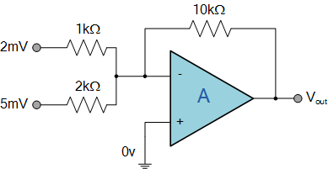
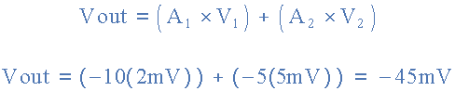
Summing Amplifier (Inverting)
Linear Applications
Home Work

Slide 66
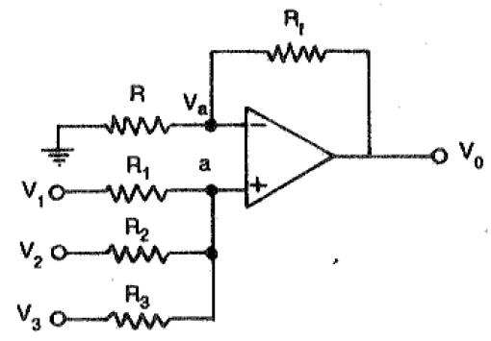
Summing Amplifier (Non - Inverting)
Linear Applications

Slide 67
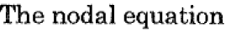
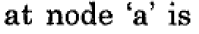
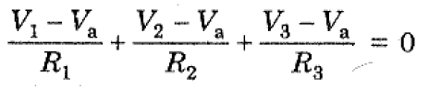
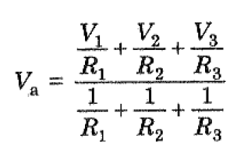
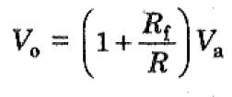
Summing Amplifier (Non - Inverting)
Linear Applications

Slide 68
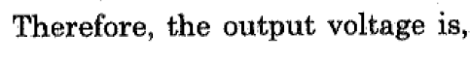

Summing Amplifier (Non - Inverting)
Linear Applications
Ref.: https://www.youtube.com/watch?v=2cqgg0PPRNg

Slide 69

Summing Amplifier (Non - Inverting)
Linear Applications
Home Work
For V₁ = 3V and V₂ = -4V We get
V_{OUT} = (6 X 3V) - (4 X 4V) = 2V

Slide 70

Subtractor
Linear Applications

Slide 71





Subtractor
Linear Applications
Use Super Position Principle,

Slide 72

Adder - Subtractor
Linear Applications

Slide 73

Adder - Subtractor
Linear Applications

Slide 74





Adder - Subtractor
Linear Applications
METHOD: 1
Use Superposition Principle, then

Slide 75

Adder - Subtractor
Linear Applications
METHOD: 1

Slide 76
Adder - Subtractor
Linear Applications
METHOD: 2
Use Nodal Analysis, then
Write Nodal equation at Node ‘a’ (Inverting Terminal)
Write Nodal equation at Node ‘b’ (Non-Inverting Terminal)
Consider, V_{a} = V_{b} ➔ V_{a} in the above two equations.
Then, V_{a} from the Step 3.
Find V₀ from Step 4.
End.

Slide 77

Adder - Subtractor
Linear Applications
Home Work
V₀ = 6.58V

Slide 78
Instrumentation Amplifier
Linear Applications
Instrumentation amplifier is a kind of differential amplifier with additional input buffer stages.
The addition of input buffer stages makes it easy to match (impedance matching) the amplifier with the preceding stage.
Instrumentation are commonly used in industrial test and measurement application.
The instrumentation amplifier also has some useful features,
Low offset voltage
High CMRR (Common mode rejection ratio)
High input resistance
High gain
High accuracy
High gain stability
Low output Resistance etc.

Slide 79

Instrumentation Amplifier
Linear Applications

Slide 80
Instrumentation Amplifier
Working of Instrumentation Amplifier
The output stage of the instrumentation amplifier is a difference amplifier,
Hence, output V_{out} is the amplified difference of the input signals applied to its input terminals.
The outputs of op-amp 1 and op-amp 2 are V_{o1} and V_{o2} respectively
V_{out} = (R₃/R₂)(V_{o1}-V_{o2})

Slide 81

Instrumentation Amplifier
Working of Instrumentation Amplifier
Consider the input stage of the instrumentation amplifier,

Slide 82
Instrumentation Amplifier
Working of Instrumentation Amplifier
The potential at node A is the input voltage V₁. Hence the potential at node B is also V₁, from the virtual ground concept. Thus, the potential at node G is also V₁.
The potential at node D is the input voltage V₂. Hence the potential at node C is also V₂, from the virtual ground. Thus, the potential at node H is also V₂.
Ideally the current to the input stage op-amps is zero. Therefore the current I through the resistors R₁, R_{gain} and R₁ remains the same.
Applying Ohm’s law between the nodes E and F,
I = (V_{o1}-V_{o2})/(R₁+R_{gain}+R₁)
I = (V_{o1}-V_{o2})/(2R₁+R_{gain}) ——————— 1
Since no current is flowing to the input of the op-amps 1 & 2, the current I between the nodes G and H can be given as,
I = (V_{G}-V_{H})/R_{gain} = (V₁-V₂)/R_{gain} ————————- 2

Slide 83
Instrumentation Amplifier
Working of Instrumentation Amplifier
Equating equations 1 and 2,
(V_{o1}-V_{o2})/(2R₁+R_{gain}) = (V1-V₂)/R_{gain}
(V_{o1}-V_{o2}) = (2R₁+R_{gain})(V₁-V₂)/R_{gain} —————— 3
The output of the difference amplifier is given as,
V_{out} = (R₃/R₂) (V_{o1}-V_{o2})
Therefore, (V_{o1} – V_{o2}) = (R₂/R₃)V_{out} —————— 4
Substituting (V_{o1} – V_{o2}) value in the equation 3, we get
(R₂/R₃)V_{out} = (2R₁+R_{gain})(V1-V₂)/R_{gain}
i.e. V_{out} = (R₃/R2){(2R₁+R_{gain})/R_{gain}}(V1-V₂)
The above equation gives the output voltage of an instrumentation amplifier.
The overall gain of the amplifier is given by the term (R₃/R2){(2R₁+R_{gain})/R_{gain}}.

Slide 84
Instrumentation Amplifier
Note:
The overall voltage gain of an instrumentation amplifier can be controlled by adjusting the value of resistor R_{gain}.
The common mode signal attenuation for the instrumentation amplifier is provided by the difference amplifier.
Advantages of Three Op-amp Instrumentation Amplifier
The gain of a three op-amp instrumentation amplifier circuit can be easily varied and controlled by adjusting the value of R_{gain} without changing the circuit structure.
The gain of the amplifier depends only on the external resistors used. Hence, it is easy to set the gain accurately by choosing the resistor values carefully.
The input impedance of the instrumentation amplifier is dependent on the non-inverting amplifier circuits in the input stage. The input impedance of a non-inverting amplifier is very high.
The output impedance of the instrumentation amplifier is the output impedance of the difference amplifier, which is very low.
The CMRR of the op-amp 3 is very high and almost all of the common mode signal will be rejected.

Slide 85
Instrumentation Amplifier
Difference between Operational Amplifier and Instrumentation Amplifier
The key differences between the operational amplifier and instrumentation amplifier include the following.
An operational amplifier (op-amp) is one kind of an integrated circuit
The instrumentation amplifier is one type of differential amplifier
Instrumentation amplifier can be built with three operational amplifiers.
The differential amplifier can be built with a single operational amplifier.
The output voltage of difference amplifier gets affected because of the mismatch resistors
Instrumentation amplifier offers gain with a single resistor of its primary phase which does not need a resistor matching.

Slide 86

Instrumentation Amplifier
Application of Instrumentation Amplifier
Transducer Bridge Instrumentation Amplifier
Ref.: https://www.electronicshub.org/instrumentation-amplifier-basics-applications/

Slide 87

Differentiator (Differentiator Amplifier)
Produces a voltage output which is directly proportional to the input voltage’s rate-of-change with respect to time

Slide 88

Differentiator (Differentiator Amplifier)
Assume it is Ideal Op-Amp, hence,
Current into the terminals are Zero
Input differential Voltage Vd = 0.
Since the node voltage of the operational amplifier at its inverting input terminal is zero, the current, i flowing through the capacitor will be given as
The charge on the capacitor equals Capacitance times Voltage across the capacitor

Slide 89



Differentiator (Differentiator Amplifier)
Thus the rate of change of this charge is:
but dQ/dt is the capacitor current, i
from which an ideal voltage output for the op-amp differentiator
Vout is a constant –Rƒ*C times the derivative of the input voltage Vin with respect to time. The minus sign (–) indicates a 180º phase shift because the input signal is connected to the inverting input terminal

Slide 90






Differentiator (Differentiator Amplifier)
Taking Laplace Transform for the above and substitute s = jɷ,

Slide 91
Differentiator (Differentiator Amplifier)
Drawbacks
Disadvantages of Ideal Differentiator :
The gain of the differentiator increases as frequency increases. Thus at some high frequency, the differentiator may become unstable and break into oscillations.
Also, the input impedance decreases as frequency increases. This makes circuit very much sensitive to the noise .

Slide 92


Differentiator (Differentiator Amplifier)
Waveforms

Slide 93
Practical Differentiator
In order to eliminate the
Instability and
High frequency noise
of the basic Differentiator, the Practical Differentiator has existence.

Slide 94

Practical Differentiator

Slide 95

Practical Differentiator
The above circuit is similar to Non-Inverting Amplifier,
V₀/V_{i} = - R_{f}/R_{i} = -Z_{f}/Z₁ ------ (1)
Remember:
Laplace Transform of,
R = R
Cd/dt = 1/sC
From the diagram,
Z_{f} = Parallel Combination of R_{f} and C_{f};
Z₁ = Series Combination of R₁ and C₁.
Z_{f} = R_{f} || C_{f} = (R_{f}/sC_{f}) / (Rf +(1/sC_{f}) ------ (2)
Z_{f} = (R_{f}) / (1+sR_{f}C₁) ------ (3)
Z₁ = R₁ + (1/sC₁) = (1+R₁C₁s)/sC₁ ------ (4)
Sub. (3) and (4) in eqn. (1), we get,
------ (5)

Slide 96



Practical Differentiator
Sub. R₁C₁ = R_{f}C_{f} in eqn. (5), we get,
------ (6)
Sub. s = jω and ω = 2Πf in eqn. (6), we get,
------ (7)

Slide 97

Practical Differentiator
Substituting the values of frequencies f_{a} and f_{b} , the gain A is

Slide 98

Practical Differentiator

Slide 99

Practical Differentiator
From the above frequency response,
f < f_{b}, the gain A is increasing at 20dB/decade.
f > f_{b}, the gain A is decreasing at 20dB/decade.
It is due to R₁C₁ & R_{f}C_{f}
For a good differentiator,
f_{a} < f_{b} < f_{c} (fc is unity gain-bandwidth of op-amp in Open loop.
T > R_{f}C₁
If, R_{f}C₁ > R₁C₁ & R_{f}C_{f} then it becomes basic Differentiator.

Slide 100

Practical Differentiator
Problem

Slide 101

Practical Differentiator
Problem

Slide 102

Practical Differentiator
Problem

Slide 103

Practical Differentiator
Problem

Slide 104

Practical Differentiator
Problem

Slide 105

Integrator

Slide 106


Integrator

Slide 107



Integrator
Taking Laplace Transform for the above and substitute s = jɷ,
or
|A| = f_{b}/f; where, f_{b} = 1/2ΠR₁C_{f}

Slide 108

Integrator

Slide 109
Integrator
From the above frequency response,
f = 0, then A is infinite (C does not conduct DC - open loop)
0 < f < f_{b}, the gain A is decreasing at 20dB/decade.
f > f_{b}, the gain A is decreasing at 20dB/decade below Zero.
Issue to be Solved is,
f = 0, then A is infinite (C does not conduct DC - open loop)

Slide 110

Practical Integrator
In order to avoid the saturation of Integration at low frequencies, an R_{f} is connected in parallel with C_{f}.

Slide 111
Practical Integrator (Lossy)
The R_{f} and C_{f} combination dissipates power, that’s why it is called as Lossy Integrator.
The gain at the Low frequency is limited to (-R_{f}/R₁) and R_{f} = 10 R₁. Thus DC stabilization is achieved.
Analysis
The above circuit is similar to Non-Inverting Amplifier,
V₀/V_{i} = - R_{f}/R_{i} = -Z_{f}/Z₁ ------ (1)
From the diagram,
Z_{f} = Parallel Combination of R_{f} and C_{f};
Z₁ = Series Combination of R₁ alone.
Z_{f} = R_{f} || C_{f} = (R_{f}/sC_{f}) / (Rf +(1/sC_{f}) ------ (2)
Z_{f} = (R_{f}) / (1+sR_{f}C₁) ------ (3)
Z₁ = R₁ ------ (4)

Slide 112

Practical Integrator (Lossy)
Analysis
Sub. (3) and (4) in eqn. (1), we get,
V₀ (s) /V_{i} (s) = - ((R_{f}/R₁) / (1+sR_{f}C_{f}) ------ (5)
Sub. s = jω and ω = 2Πf in eqn. (5), we get,
Sub. f_{a} = 1 / 2ΠR_{f}C_{f} above eqn. becomes,
|A| = - ((R_{f}/R₁) / √(1+(f/f_{a})²) ------ (6)

Slide 113
Practical Integrator (Lossy)
Analysis
|A| = - ((R_{f}/R₁) / √(1+(f/f_{a})²) ------ (6)
Consider the following cases:
1. When f=0 ,the gain |A|=|R_{f}/R₁| —–dc gain 2. When 0<f<f_{a} ,the gain |A|≅|R_{f}/R₁| 3. When f>f_{a} ,the gain |A|≪|R_{f}/R₁| 4. When f= f_{a} , the gain |A|=|R_{f}/R₁ (1/√2) |
Hence, |A|=|0.707 (R_{f}/R₁) |

Slide 114

Practical Integrator (Lossy)
1. When f=0 ,the gain |A|=|R_{f}/R₁| —–dc gain 2. When 0<f<f_{a} ,the gain |A|≅|R_{f}/R₁| 3. When f>f_{a} ,the gain |A|≪|R_{f}/R₁| 4. When f= f_{a} , the gain |A|=|R_{f}/R₁ (1/√2) |
Hence, |A|=|0.707 (R_{f}/R₁) |

Slide 115
Practical Integrator (Lossy)
Thus we can have following observations from frequency response of practical integrator:
Bandwidth of practical integrator is f_{a} which is higher than BW of an ideal integrator.
DC gain (at f=0) is |R_{f}/R₁| which is typically ≥10.
For better integration f_{b} ≥ 10f_{a} (99% Accuracy).
For proper integration Time period T of input signal ≥R_{f} C_{f}

Slide 116

Practical Integrator (Lossy)
Problem

Slide 117


Practical Integrator (Lossy)
Solution

Slide 118

Practical Integrator (Lossy)
Solution

Slide 119

Practical Integrator (Lossy)
Solution

Slide 120


Practical Integrator (Lossy)
Solution

Slide 121



Practical Integrator (Lossy)
Solution

Slide 122
Active Filters

Slide 123
Active Filters
Filters are circuits that are capable of passing signals within a band of frequencies while rejecting or blocking signals of frequencies outside this band. This property of filters is also called “frequency selectivity”.
Filter can be Passive or Active filter.
Passive filters:
The circuits built using RC, RL, or RLC circuits.
Active filters :
The circuits that employ one or more op-amps in the design an addition to resistors and capacitors

Slide 124
Active Filters
There are two broad categories of filters:
An analog filter processes continuous-time signals
A digital filter processes discrete-time signals.
The analog or digital filters can be subdivided into four categories:
Low pass Filters
High pass Filters
Band stop Filters
Band pass Filters

Slide 125

Active Filters

Slide 126
Active Filters
Passive Filters Disadvantages:
Made up of passive components - resistors, capacitors and inductors
No amplifying éléments (transistors, op-amps, etc)
No signal gain
1st order - design is simple (just use standard equations to find resonant frequency of the circuit)
2nd order - complex equations
Require no power supplies
Buffer amplifiers might be required
Desirable to use inductors with high quality factors
Inductor
Physical size, and large inductance values are required.
Often prohibitively expensive.
Difficult to implement at frequencies below 1 kHz.
Lossy

Slide 127
Active Filters
Active Filters Advantages:
No inductors
Made up of op-amps, resistors and capacitors
Provides arbitrary gain
High input impedance prevents excessive loading of the driving source
Low output impedance prevents the filter from being affected by the load
Easy to adjust over a wide frequency range without altering the desired response.
Reduced size and weight
Increased reliability and improved performance

Slide 128

Active Filters
First Order Low Pass Filter

Slide 129


V = IR
I = V/R

Slide 130
Active Filters
In the circuit we have:
Voltage ‘Vin’ as an input voltage signal which is analog in nature.
Voltage ‘Vo’ is the output voltage of the operational amplifier.
Resistors ‘R_{F}’ and ‘R₁’ are the negative feedback resistors of the operational amplifier.
There is a single R-C network (marked in the red square) present in the circuit hence the filter is a first-order low pass filter
‘R_{L}’ is the load resistance connected at the op-amp output.

Slide 131
Active Filters
V₀ = (1 + (R_{f}/R_{i}))V₁ ------ (1)
Apply Nodal eqn. at Node V₁,
(V₁-V_{i})/R + C(dV₁/dt) = 0
(V₁/R) + C(dV₁/dt) = (V_{i}/R) ---- (2)
Taking Laplace Transform in eqn (2),
(V₁(s)/R) + sCV₁(s) = V_{i}(s)/R ---- (3)
Simplifying eqn (3),
V₁(s) = V_{i}(s)/(1+sCR) ---- (4)
V₁(s)/V_{i}(s) = 1/(1+sCR) ---- (5)

Slide 132
Active Filters
From eqn. (1), the Closed Loop Gain (A₀) is,
A₀ = V₀(s)/ V₁(s) = (1 + (R_{f}/R_{i})) ------ (6)
From the diagram, the overall Transfer function is,
H(s) = V₀(s)/ V_{i}(s) = (V₀(s)/ V₁(s)) . (V₁(s)/ V_{i}(s)) ------ (7)
Using eqn. (5) and (6) in (7) gives,
H(s) = (1 + (R_{f}/R_{i})) /(1+sCR) ------ (8)
Or
H(s) = A₀ /(1+sCR) ------ (9)
Where, A₀ is Gain of Non-Inverting Amp.
Ref.: https://circuitdigest.com/tutorial/butterworth-filters-first-order-and-second-order-low-pass-butterworth-filters

Slide 133
Active Filters
H(s) = A₀ /(1+sCR) ------ (9)
Sub. ω_{h} = 1/RC in eqn. (9), then,
H(s) = V₀(s)/ V_{i}(s) = A₀ /(1+s/ ω_{h} )
H(s) = A₀ω_{h}/(ω_{h}+s) ------ (10)
Put s = jω in eqn. (9), then,
H(jω) = A₀ /(1+ jωCR) ------ (11)
Use f_{h} = 1/2ΠRC (Cut-off frequency of the Filter) in eqn. (11) then,
H(jω) = A₀ /(1+ j(f/f_{h})) ------ (12)
|H(jω)| = A₀ /√(1+ (f/f_{h})²) ------ (13)

Slide 134

Active Filters
|H(jω)| = A₀ /√(1+ (f/f_{h})²) ------ (13)
Case i : f << f_{h} (input frequency is very less than the cutoff frequency), ==> |H(jω)| = A₀
Case ii : f = f_{h} (input frequency is equal to the cutoff frequency),
==> |H(jω)| = 0.707 A₀
Case iii: f > f_{h} (input frequency is higher than the cutoff frequency),
==> |H(jω)| < A₀ (20 dB/decade)

Slide 135

Active Filters
Second Order Low Pass Filter

Slide 136
Active Filters
Second Order Low Pass Filter
For a Non-Inverting Amplifier,
V₀ = (1 + (R_{f}/R_{i})) V_{B} ------ (1)
A₀ = V₀/V_{B} = (1 + (R_{f}/R_{i})) ------ (2)
Apply Nodal eqn. at Node A (V_{A} ),
V_{A} (2/R+sC)) = V_{i}/R+V_{B}/R+V₀sC ---- (3)
Apply Nodal eqn. at Node B (V_{B} ),
V_{A}/R = V_{B}((1/R)+sC) ---- (4)

Slide 137
Active Filters
Second Order Low Pass Filter
From eqn. (2),
A₀ = V₀/V_{B} ------ (2)
V_{B} = V₀/A₀ ------ (5)
Sub. Eqn. (5) in eqn. (4)
V_{A} = V₀/A₀(1+sCR) ---- (6)
Sub. Eqn. (6) in eqn. (3)
H(s) = V₀/V_{i} = A₀/ (1+sCR(3-A₀)+(sCR)²) ---- (7)

Slide 138
Active Filters
Second Order Low Pass Filter
The Transfer function of 2nd order LPF in terms of ω as,
H(s) = A₀ω_{h}² / (s²+αω_{h}s+(ω_{h})²) ---- (8)
Or
H(s) = A₀ / ((s²/ω_{h}² ) +(αs/ω_{h} ) +1) ---- (9)
A₀ = Gain of Closed loop Amplifier
ω_{h} = Upper Cutoff frequency in rad/sec.
α = Damping Co-efficient
Comparing . Eqn. (7) and eqn. (9)
ω_{h} = 1/RC; or f_{h} = 1/2ΠRC
α = 3-A₀

Slide 139

Active Filters

Slide 140

Active Filters

Slide 141

Active Filters
Higher order Butterworth filters are obtained by cascading first and second order Butterworth filters.

Slide 142

Active Filters
Higher order Butterworth filters are obtained by cascading first and second order Butterworth filters.

Slide 143
Active Filters
Problem:
Design a 2nd order Butterworth LPF having fh = 1kHz. Discuss the frequency response.

Slide 144
Active Filters
Solution:
f_{h} = 1/2ΠRC
Assume, C=0.1 µF, then the R is 1.6kΩ.
From the Table, for n=2 (2nd Order), α = 1.414,
hence the Pass band gain A₀ = 3-α = 1.586.
A₀ = (1 + (R_{f}/R_{i})) = 1.586 and assume, R_{i}=10kΩ
hence, R_{f} = 5.86kΩ
Hence the Transfer function is, H(s) = 1.586 / (s_{n}²+1.414s_{n}+1)

Slide 145
Active Filters
Problem:
_{Design a 4}^{th} order Butterworth LPF having fh = 1kHz. Discuss the frequency response.

Slide 146
Active Filters
Solution:
f_{h} = 1/2ΠRC
Assume, C=0.1 µF, then the R is 1.6kΩ.
From the Table, for n= 4 (4th Order), α₁ = 0.765, α₁ = 1.848,
hence the Pass band gain
A₀₁ = 3-α₁ = 2.235
A₀₂ = 3-α₂ = 1.152
A₀₁ = (1 + (R_{f}/R_{i1})) = 2.235 and assume, R_{i1}=10kΩ ➔ hence, R_{f22} = 12.35kΩ
A₀₂ = (1 + (R_{f}/R_{i2})) = 1.152 and assume, R_{i2}=100kΩ ➔ hence, R_{f2} = 15.2kΩ
Hence the Transfer function is,
H(s) = [2.235 / (s_{n}²+ 0.765 s_{n}+1)]. [1.152 / (s_{n}²+ 1.848 s_{n}+1)]

Slide 147

Active Filters
Second Order High Pass Filter
Consider R=R₁=R₂ and C=C₁=C₂.
Apply the same procedure as discussed for the 2nd Order LPF, and obtain H(s)

Slide 148
Active Filters
Second Order High Pass Filter
H(s) = A₀s² / (s²+αω_{l}s+(ω_{l})²) ---- (1)
Or
H(s) = A₀ / ((ω_{l}²/s²) +(αω_{l}/s) +1) ---- (2)
H(s) = V₀/V_{i} = A₀/ [1+ ((3-A₀)/sCR)+(1/(sCR)²)] ---- (3)
Comparing . Eqn. (2) and eqn. (3)
ω_{l} = 1/RC; or f_{l} = 1/2ΠRC
α = 3-A₀

Slide 149
Active Filters
Problem:
_{Design a 2}^{nd} order Butterworth HPF having fl = 1kHz. Discuss the frequency response.

Slide 150
Active Filters
Solution:
f_{h} = 1/2ΠRC
Assume, C=0.1 µF, then the R is 1.6kΩ.
From the Table, for n=2 (2nd Order), α = 1.414,
hence the Pass band gain A₀ = 3-α = 1.586.
A₀ = (1 + (R_{f}/R_{i})) = 1.586 and assume, R_{i}=10kΩ
hence, R_{f} = 5.86kΩ
Hence the Transfer function is, H(s) = 1.586 / (s_{n}²+1.414s_{n}+1)

Slide 151

Active Filters
Wide Band Pass Filter
First order BPF = Cascade of First order HPF and LPF

Slide 152
Active Filters
Wide Band Pass Filter
HPF
H(jɷ) = A₀₁(jf/f_{l}) / [1+j(f/f_{l})]
H(jɷ) = A₀₁(f/f_{l}) / √[1+(f/f_{l})²] -----(1)
LPF
H(jɷ) = A₀₁ / [1+j(f/f_{h})]
H(jɷ) = A₀₁ / √[1+(f/f_{h})²] -----(2)
Total Gain A₀ = A₀₁. A₀₂
H(jɷ) = A₀ (f/f_{l})/ √{[1+(f/f_{h})²]. [1+(f/f_{l})² } -----(3)

Slide 153


Active Filters
Wide Band Reject Filter

Slide 154

Active Filters
Wide Band Reject Filter

Slide 155

Active Filters
Wide Band Reject Filter
Design a basic wide-band, RC band stop filter with a lower cut-off frequency of 200Hz and a higher cut-off frequency of 800Hz. Find the geometric center frequency, -3dB bandwidth and Q of the circuit.

Slide 156


Active Filters
Wide Band Reject Filter

Slide 157
Active Filters
All Pass Filter
The Other names are,
Phase shift Filters
Constant delay Filters
The phase difference between input and output is CONSTANT among all frequencies.
There are two types,
Phase Lag Filters
Phase Lead Filters
They can be obtained by changing the phase angle between Z₁ and Z_{f}.

Slide 158
Active Filters
All Pass Filter
Feedback and inverting input resistors must be equal to each other
Absolute values of resistors is not critical, but for minimum offset, parallel equivalent of these two resistors should nearly equal the value of R₁
Gain of all-pass filter is unity (a necessary condition for normal operation)
By replacing R₁ with a potentiometer (or equivalent voltage-controlled resistance), phase angle of output may be varied continuously
Cascading similar all-pass sections produces and additive phase shift
Two all-pass filters cascaded will approach a maximum phase shift of 360°, three sections will approach a maximum phase shift of 540°,..

Slide 159

Active Filters
All Pass Filter – Phase Lag Filter

Slide 160
Active Filters
All Pass Filter – Phase Lag Filter
Designed to provide constant gain to signals at all frequencies
Ideally, cover entire frequency spectrum
Flat amplitude response characteristic is quite different from those of other filters (LP, HP, BP, notch)
Produce an output that is shifted in phase relative to input signal
Figure: Output signal lag that of input
For frequencies approaching 0, phase lag approaches 180°
As frequency increases, phase lag of output approaches 0
Phase angle: Ø = -2 tan⁻¹ [2πfRC]

Slide 161
Active Filters
All Pass Filter – Phase Lag Filter
At node ‘a’,
(V_{a}-V_{in}/R₁) +(V_{a}-V₀/R_{f}) = 0
If R₁=R_{f} then,
(V_{a}-V_{in}/R₁) +(V_{a}-V₀/R₁) = 0
V_{in} = 2V_{a}-V₀ ------(1)
At node ‘b’,
(V_{b}-V_{in}/R) +(V_{b}-0/(1/sC)) = 0
V_{b} = V_{in}/(1+sCR) -----(2)
V_{a} = V_{b}; hence sub. Eqn. (2) in eqn. (1),
V₀ = V_{in} (1-sCR)/(1+sCR) ----(3)
H(s) = V₀/V_{in} = (1-sCR)/(1+sCR) ----(4)

Slide 162

Active Filters
All Pass Filter – Phase Lag Filter
H(jω) = V₀/V_{in} = (1-jωCR)/(1+jωCR) ----(4)
Magnitude of |H(jω)| = √{(1+(ωCR)²)/((1+(ωCR)²) = 1
Phase of |H(jω)| = tan⁻¹(-ωCR) - tan⁻¹(ωCR)
= -tan⁻¹(-ωCR) - tan⁻¹(ωCR)
= -2 tan⁻¹(-ωCR)
ϕ= -2 tan⁻¹(f/f₀) (ஃ f₀=1/2ΠRC)
When, f=0; ϕ= 0°
f=f₀; ϕ= -90°
f=α; ϕ= -180°

Slide 163

Active Filters
All Pass Filter – Phase Lag Filter

Slide 164

Active Filters
All Pass Filter – Phase Lag Filter

Slide 165
Active Filters
All Pass Filter – Phase Lead Filter
Designed to provide constant gain to signals at all frequencies
Ideally, cover entire frequency spectrum
Flat amplitude response characteristic is quite different from those of other filters (LP, HP, BP, notch)
Produce an output that is shifted in phase relative to input signal
Figure: Output signal leads that of input
For frequencies approaching 0, phase lead approaches 180°
As frequency increases, phase lead of output approaches 0
Phase angle: Ø = 2 tan⁻¹ [1/(2πfR₁C₁)]

Slide 166
Active Filters
All Pass Filter – Phase Lead Filter
At node ‘a’,
(V_{a}-V_{in}/R₁) +(V_{a}-V₀/R_{f}) = 0
If R₁=R_{f} then,
(V_{a}-V_{in}/R₁) +(V_{a}-V₀/R₁) = 0
V_{in} = 2V_{a}-V₀ ------(1)
At node ‘b’,
(V_{b}-V_{in}/(1/sC)) +(V_{b}-0/(R) = 0
V_{b} = (sCRV_{in} )/(1+sCR) -----(2)
V_{a} = V_{b}; hence sub. Eqn. (2) in eqn. (1),
V₀ = V_{in} (-1+sCR)/(1+sCR) ----(3)
H(s) = V₀/V_{in} = (-1+sCR)/(1+sCR) ----(4)

Slide 167

Active Filters
All Pass Filter – Phase Lead Filter
Magnitude of |H(jω)| = √{(1+(ωCR)²)/((1+(ωCR)²) = 1
Phase of |H(jω)| = tan⁻¹(ωCR/(-1)) - tan⁻¹(ωCR)
= 180°-tan⁻¹(ωCR) - tan⁻¹(ωCR)
ϕ = 180°-2 tan⁻¹(-ωCR)
ϕ= 180°- 2 tan⁻¹(f/f₀) (ஃ f₀=1/2ΠRC)
When, f=0; ϕ= 180°
f=f₀; ϕ= 90°
f=α; ϕ= 0°

Slide 168

Active Filters
All Pass Filter – Phase Lead Filter

Slide 169

http://www.brainkart.com/article/Important-Short-Questions-and-Answers--Characteristics-of-op-amp_13381/
http://www.ecircuitcenter.com/RunSPICE.htm

